Slide 1
Models for Cardiovascular Disease Prediction
Group14: 0617044顧啟耀, H092625葉庭渝

Slide 2
Outlines
Abstract
Introduction
Dataset
Method
Result
Discussion

Slide 3
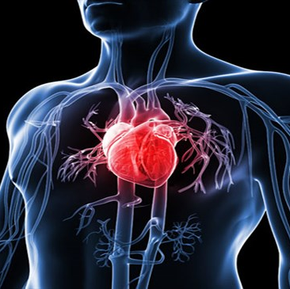
Abstract
The topic of this report is regarding to ‘Cardiovascular Disease’, there are objective, examination, and subjective data in the used dataset.
We build the many kinds of models, like decision tree, Bayesian classifier, etc.
Compare and summarize these models in the end.

Slide 4
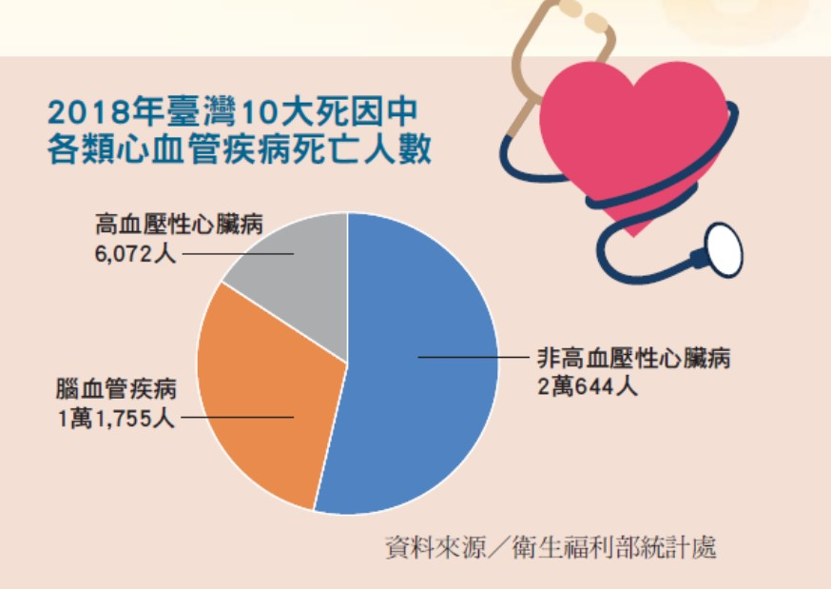
Introduction
The cardiovascular disease is the common severe disease which cause death in Taiwan. Using the data to predict whether the cardiovascular disease in the patient is important for preventive healthcare.
We would like to compare the models based on different machine learning algorithms and try to build the well-performed model to predict.
38471 people dead from cardiovascular disease in Taiwan in 2018

Slide 5


Dataset
Open data from Kaggle, 12 +1 Features, 2000 Observations
Feature Name | Feature Type | Data Type
Age | Objective | int (days)
Height |  | int (cm)
Weight |  | float (kg)
BMI |  | float
Gender |  | 1:women; 2:men
Systolic blood pressure | Examination | int
Diastolic blood pressure |  | int
Cholesterol |  | 1:normal; 2:above normal; 3 well above normal
Glucose
Smoking | Subjective | 1:Yes, 0:No
Alcohol intake
Physical activity
Cardiovascular | Target Variable
BMI is the new added feature.

Slide 6
Method
Processed by Python and Weka

Slide 7
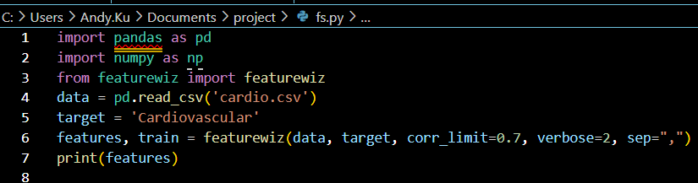
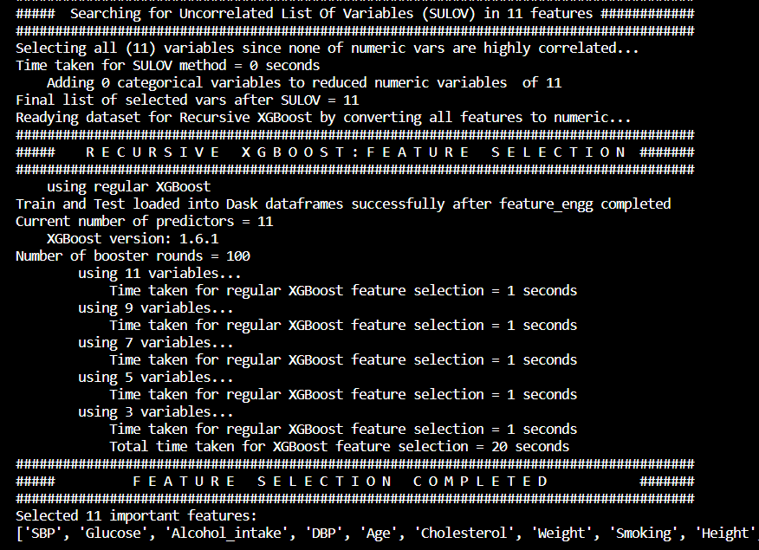
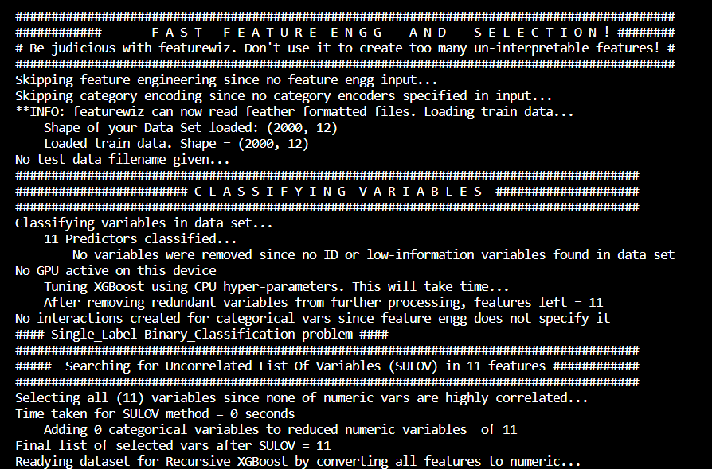
Feature Selection

Slide 8
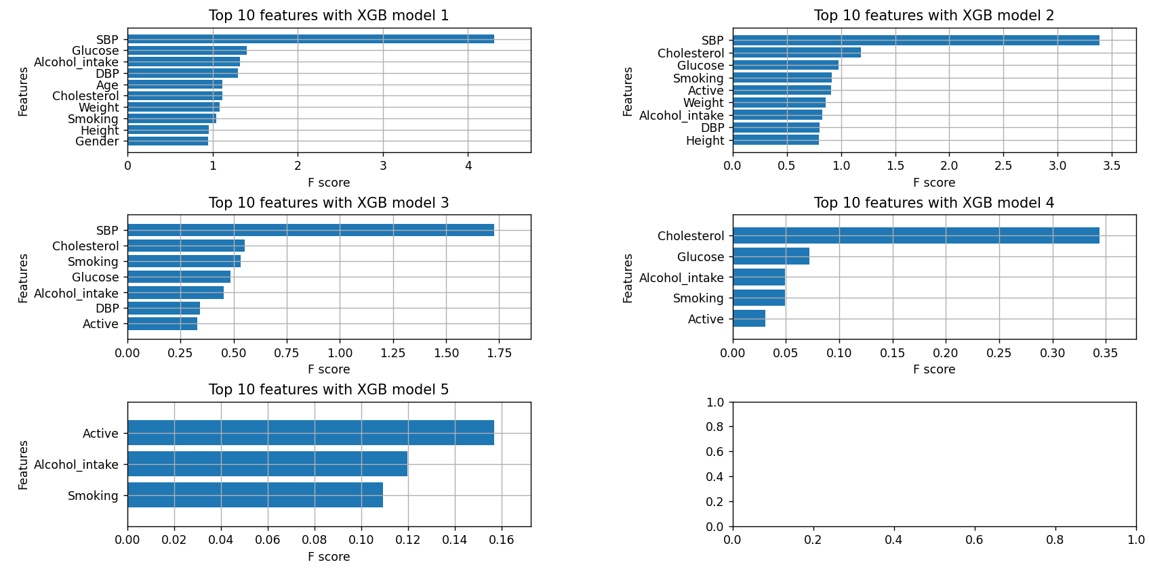
Feature Selection

Slide 9
Data Processing & Model Building
Split dataset to 70% training and 30% testing.
Model by Weka
Model by Python
J48 Binary Split Decision Tree -> Discretize
Naïve Bayesian Classifier -> Discretize
KNN -> Discretize
Random Forest
XGB Classifier (Trial and Error) params (max_depth=4,colsample_bytree=0.5, learning_rate=0.001, n_estimators=200, subsample=0.8, min_child_weight=50)
SVC-SVM (Trial and Error) -> Grid Search & SVC params (C=10, gamma=0.0001, kernel=‘rbf’)
ANN -> Keras Sequential

Slide 10
Result
Performance of the models

Slide 11
Performance of Independent Tests
Method | Accuracy | Precision | Recall | Specificity
J48 Decision Tree | 77.0% | 68.8% | 63.5% | 89.4%
Naïve Bayesian Classifier | 76.8% | 73.5% | 66.4% | 76.2%
Random Forest | 72.8% | 74.9% | 67.6% | 78.0%
KNN | 77.3% | 78.4% | 72.9% | 81.4%
ANN | 71.8% | 75.9% | 62.5% | 81.7%
XGB Classifier | 73.8% | 75.0% | 63.1% | 63.0%
SVC-SVM | 69.5% | 67.2% | 63.5% | 63.5%

Slide 12
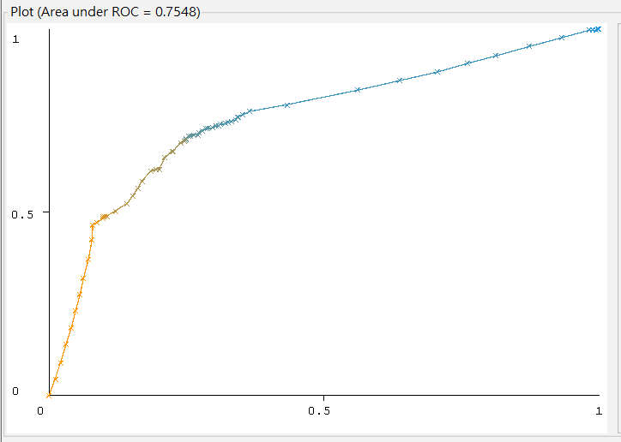
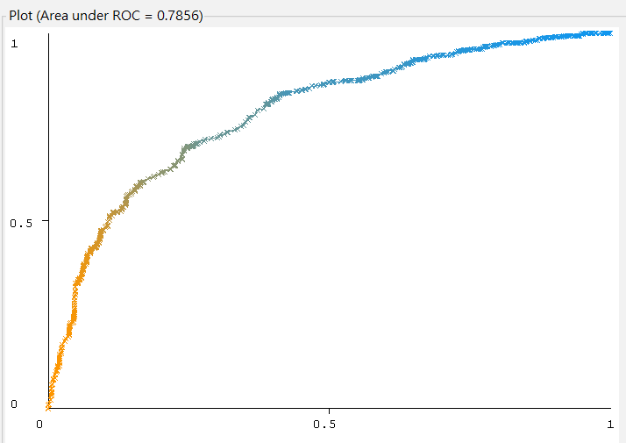
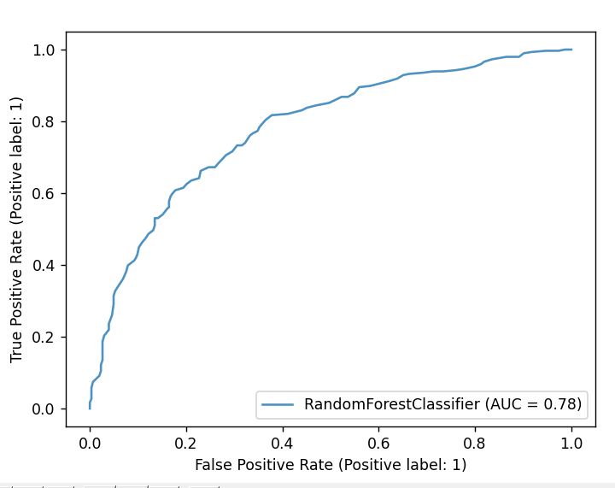
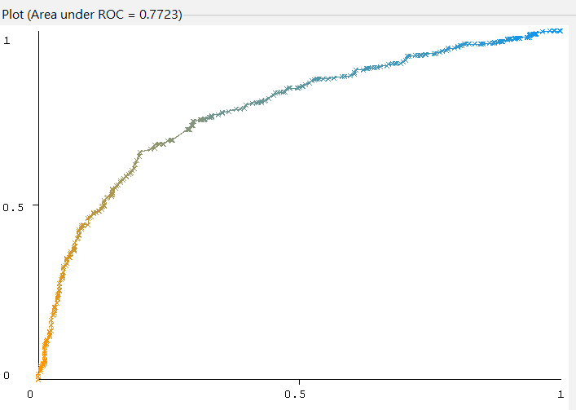
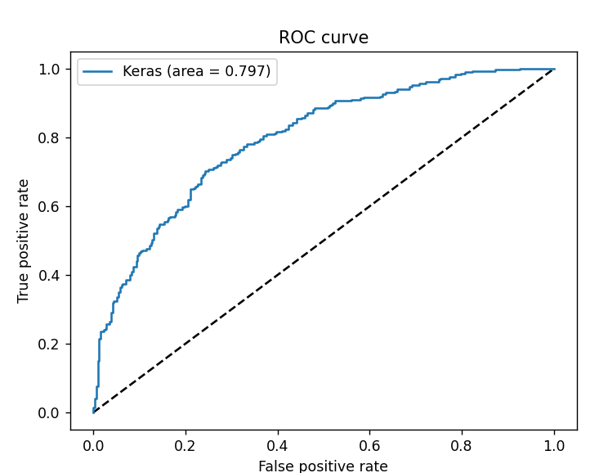
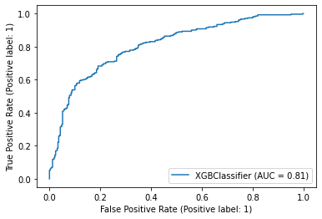
ROC Curves
Method | Area Under ROC Curve
J48 Decision Tree | 0.75
Naïve Bayesian Classifier | 0.78
Random Forest | 0.79
KNN | 0.77
ANN | 0.80
XGB Classifier | 0.81
SVC-SVM | 0.75
J48 Decision Tree
Naïve Bayesian Classifier
Random Forest
KNN
XGB
ANN

Slide 13
Discussion

Slide 14
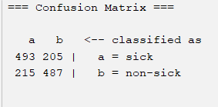
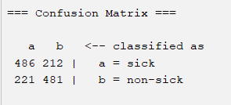
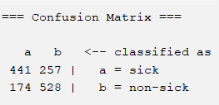
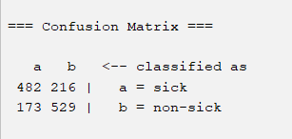
Discretizing would improve the performance in many models
There are all improvements in J48, KNN, and Bayesian.
 | No new feature | Feature ‘BMI’ addition
No discretize | Sensitivity:0.706 Specificity:0.693 | Sensitivity:0.696 Specificity:0.685
Discretize | Sensitivity:0.631 Specificity:0.752 | Sensitivity:0.690 Specificity:0.753

Slide 15
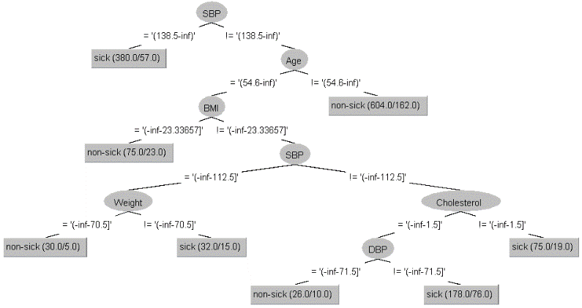
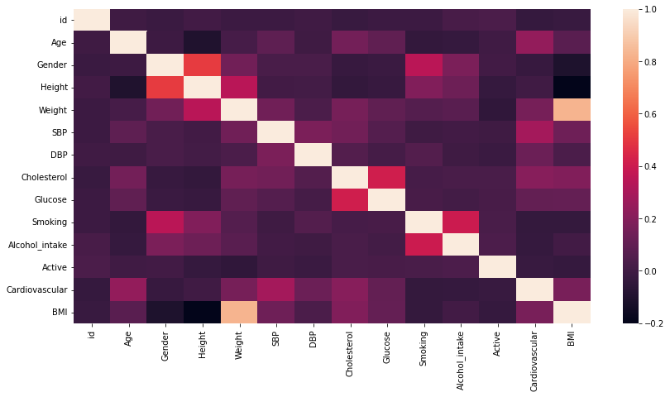
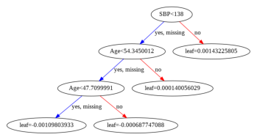
Tree Graph of Decision Tree and XGB Classifier
Heatmap of all correlation between every two features
Decision Tree
XGB Classifier

Slide 16
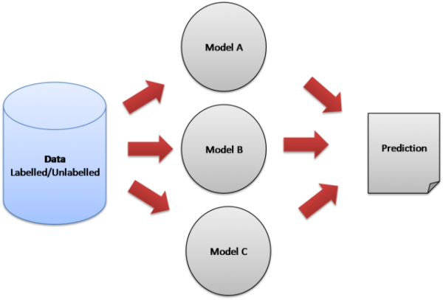
Summary
KNN is the most well-performed in ‘independent test’, and there is the largest AUC in XGB classifier.
We may use techniques of ensemble learning for the better performance in the future works.
The upgraded skills of feature selection may lead the better performance.

Slide 17
Team
Gu, Chi-Yao Feature Selection, Model (Decision Tree, Random Forest, Bayes Classifier, KNN, ANN)
Yeh, Ting-Yu EDA, Model (XGB, SVM), Summarization

Slide 18
Thank you

